Slide 1
WAN Connections
Configuring Serial Encapsulation

Slide 2
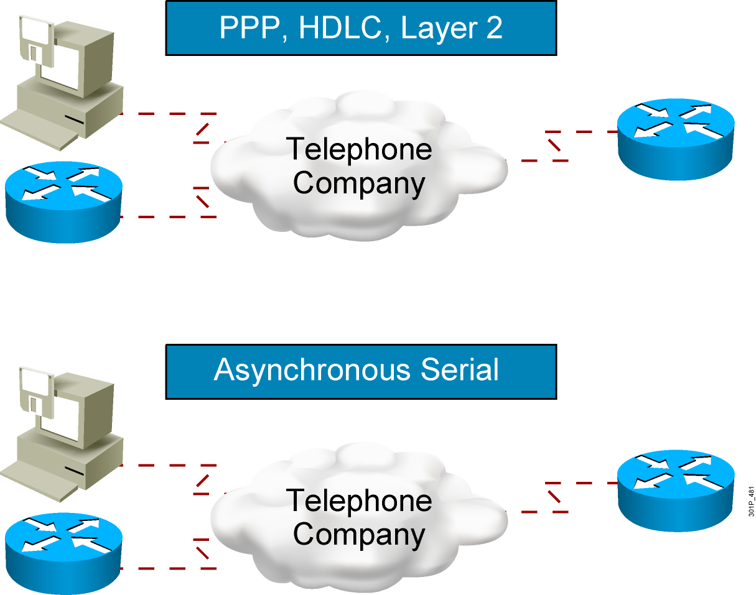
Circuit Switching
Notes:
Lesson Aim
<Enter lesson aim here.>

Slide 3
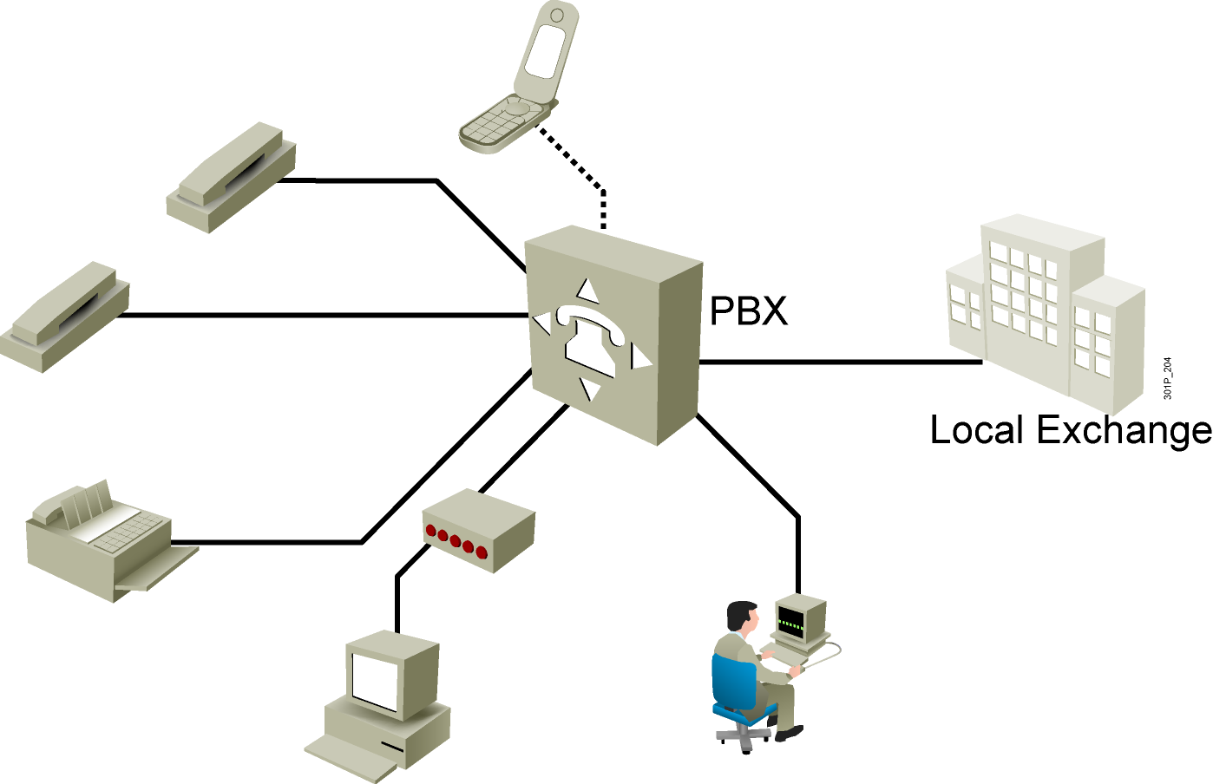
Public Switched Telephone Network

Slide 4
PSTN Considerations
Advantages
  Simplicity
  Availability
  Cost
Disadvantages
  Low data rates
  Relatively long connection setup time

Slide 5
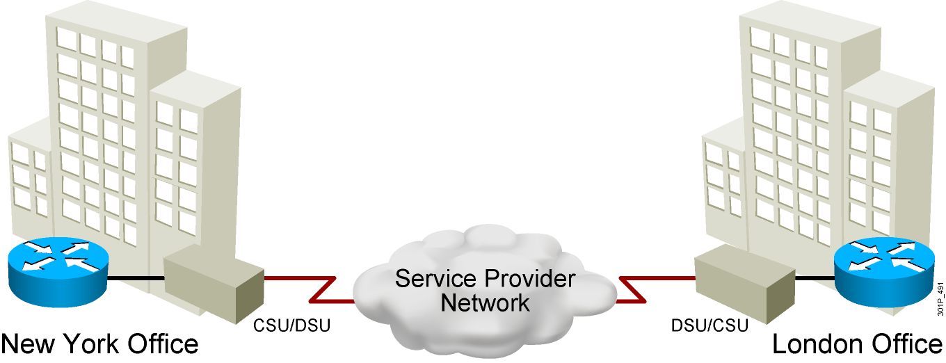
Leased Line
Notes:
Lesson Aim
<Enter lesson aim here.>

Slide 6
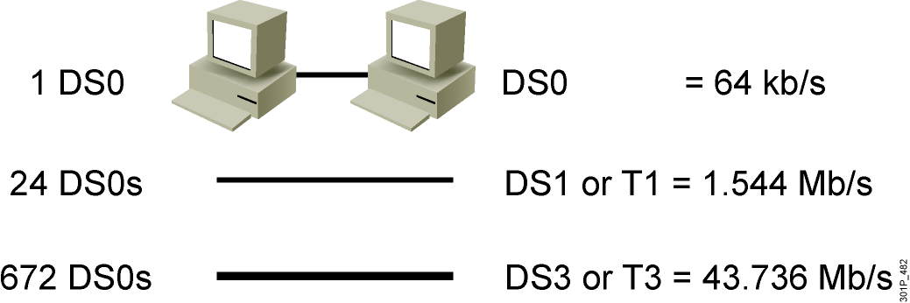
WAN Connection Bandwidth
Notes:
Lesson Aim
<Enter lesson aim here.>

Slide 7
Configuring a Serial Interface
RouterX#configure terminal
RouterX(config)#
Enter global
configuration mode.
Specify interface.
RouterX(config)#interface serial 0/0/0
RouterX(config-if)#
Set clock rate
(on DCE interfaces only).
RouterX(config-if)#clock rate 64000
RouterX(config-if)#
RouterX(config-if)#bandwidth 64
RouterX(config-if)#exit
RouterX(config)#exit
RouterX#
Set bandwidth
(recommended).
Notes:
Layer 2 of 2
Purpose: This slide shows two configuration parameters for the serial interface.
Emphasize: Layer 2— Issue the clock rate command with the desired speed. On serial links, one side of the link acts as the DCE and the other side of the link acts as the DTE. By default, Cisco routers are DTE devices, but can be configured as DCE devices. In a “back-to-back” cable configuration where a modem is not used, one end must provide the clocking signal. You must specify a clock rate for the DCE interface end in this type of environment. Desired clock rate is in bits per second. Be sure to enter the complete clock speed. For example, a clock rate of 56000 cannot be abbreviated to 56. If you are using an EIA/TIA-232 cable, using a high clock rate may cause errors on the line. Use the show controller serial 0 command to verify if the router has a DCE or DTE cable connected to it. Note, the router only reads the DCE/DTE cable information at startup.
The bandwidth command overrides the default bandwidth (1.544M). The bandwidth parameter (in kbps) is used to calculate statistics like load and it is used by routing protocols such as IGRP. We will learn more about routing protocols in Chapter 9, “Determining IP Routes.”
To return to privileged EXEC mode, enter exit until the privileged EXEC prompt appears.
Note: In the lab, the core router has the DCE cables and the workgroup router has the DTE cable.

Slide 8
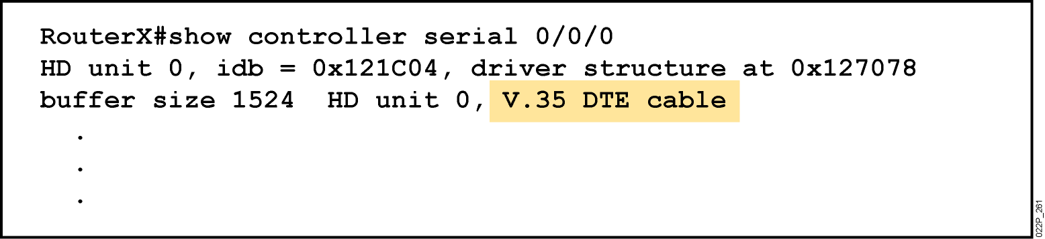
Serial Interface show controller Command
Shows the serial cable type
Notes:
Emphasize: This command requires a space between the word serial and the interface number. The router only checks for the cable type at powerup.

Slide 9
Point-to-Point Considerations
Advantages
  Simplicity
  Quality
  Availability
Disadvantages
  Cost
  Limited flexibility

Slide 10
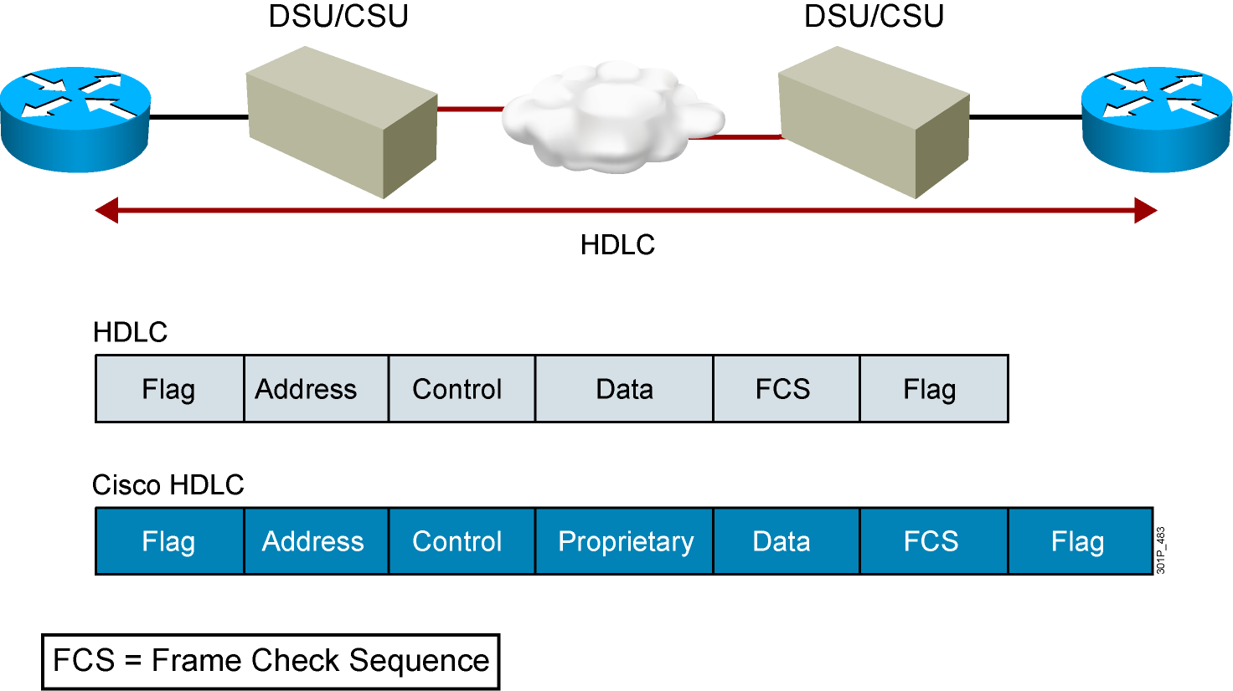
HDLC and Cisco HDLC
Notes:
Lesson Aim
<Enter lesson aim here.>

Slide 11
Configuring HDLC Encapsulation
RouterX(config-if)# encapsulation hdlc
Enables Cisco HDLC encapsulation
Uses the default encapsulation on synchronous serial interfaces
Notes:
Purpose: This figure describes how to configure HDLC on a serial connection.
Emphasize: The encapsulation hdlc command is the default encapsulation on a Cisco router’s serial connection.
Transition: If the network consists of Cisco and non-Cisco devices, you should use PPP instead of HDLC.

Slide 12
Leased Line
Notes:
Lesson Aim
<Enter lesson aim here.>

Slide 13
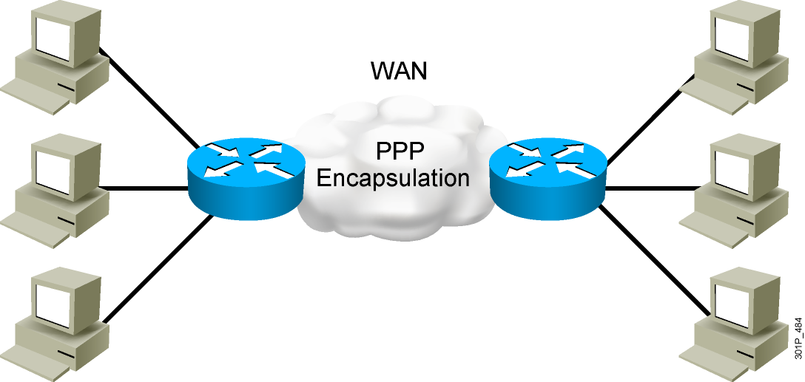
PPP
Notes:
Lesson Aim
<Enter lesson aim here.>

Slide 14
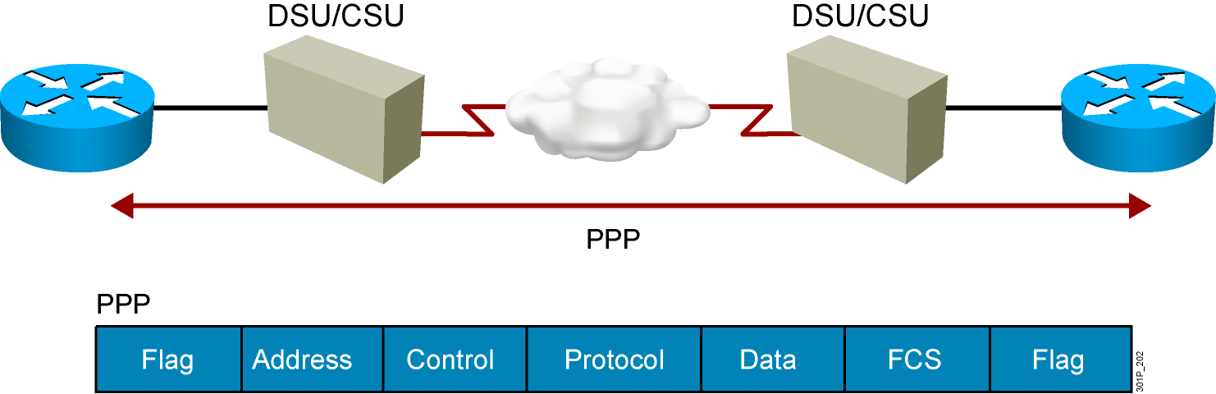
An Overview of PPP
  PPP can carry packets from several protocol suites
  using NCP.
  PPP controls the setup of several link options using LCP.
Notes:
Purpose: This figure presents an overview of PPP.
Emphasize: The figure illustrates the multiple protocols that NCP supports.
The two arrows pointing to the router interfaces are where PPP encapsulation occurs.
The first bullet summarizes the role of NCP. The second bullet summarizes the role of the LCP options that the administrator can use to set up and control the data link.
Several RFCs are used to specify aspects of PPP. RFC 1548 is the major specification for the major PPP NCP and LCP operations.

Slide 15
Enable PPP Encapsulation
RouterX(config-if)# encapsulation ppp
Enables PPP encapsulation
Notes:
Purpose: This figure describes how to encapsulate PPP on an interface.

Slide 16
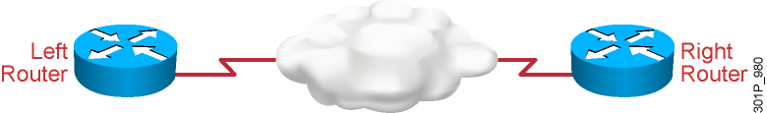
PPP Configuration Example
hostname left
!
int serial 0
ip address 10.0.1.1 255.255.255.0
encapsulation ppp
hostname right
!
int serial 0
ip address 10.0.1.2 255.255.255.0
encapsulation ppp
Notes:
Purpose: This page shows an example of CHAP configuration between two routers.
Emphasize: When you configure the usernames and passwords for the local databases, the passwords on both systems must be identical. Usernames and passwords are case sensitive.
Transition: The next section shows how to verify that the connection is operating as intended.

Slide 17
Verifying a Serial Interface Configuration
RouterX# show interface s0/0/0
Serial0/0/0 is up, line protocol is up
Hardware is HD64570
Internet address is 10.140.1.2/24
MTU 1500 bytes, BW 1544 Kbit, DLY 20000 usec, rely 255/255, load 1/255
Encapsulation PPP, loopback not set, keepalive set (10 sec)
LCP Open
Open: IPCP, CDPCP
Last input 00:00:05, output 00:00:05, output hang never
Last clearing of "show interface" counters never
Queueing strategy: fifo
Output queue 0/40, 0 drops; input queue 0/75, 0 drops
5 minute input rate 0 bits/sec, 0 packets/sec
5 minute output rate 0 bits/sec, 0 packets/sec
38021 packets input, 5656110 bytes, 0 no buffer
Received 23488 broadcasts, 0 runts, 0 giants, 0 throttles
0 input errors, 0 CRC, 0 frame, 0 overrun, 0 ignored, 0 abort
38097 packets output, 2135697 bytes, 0 underruns
0 output errors, 0 collisions, 6045 interface resets
0 output buffer failures, 0 output buffers swapped out
482 carrier transitions
DCD=up DSR=up DTR=up RTS=up CTS=up

Slide 18
Verifying the HDLC and PPP Encapsulation Configuration
RouterX# show interface s0/0/0
Serial0/0/0 is up, line protocol is up
Hardware is HD64570
Internet address is 10.140.1.2/24
MTU 1500 bytes, BW 1544 Kbit, DLY 20000 usec, rely 255/255, load 1/255
Encapsulation PPP, loopback not set, keepalive set (10 sec)
LCP Open
Open: IPCP, CDPCP
Last input 00:00:05, output 00:00:05, output hang never
Last clearing of "show interface" counters never
Queueing strategy: fifo
Output queue 0/40, 0 drops; input queue 0/75, 0 drops
5 minute input rate 0 bits/sec, 0 packets/sec
5 minute output rate 0 bits/sec, 0 packets/sec
38021 packets input, 5656110 bytes, 0 no buffer
Received 23488 broadcasts, 0 runts, 0 giants, 0 throttles
0 input errors, 0 CRC, 0 frame, 0 overrun, 0 ignored, 0 abort
38097 packets output, 2135697 bytes, 0 underruns
0 output errors, 0 collisions, 6045 interface resets
0 output buffer failures, 0 output buffers swapped out
482 carrier transitions
DCD=up DSR=up DTR=up RTS=up CTS=up
Notes:
Purpose: This graphic presents the show interface command, which is used to verify that PPP encapsulation is configured on the interface. The same command is used to verify proper HDLC configuration.

Slide 19
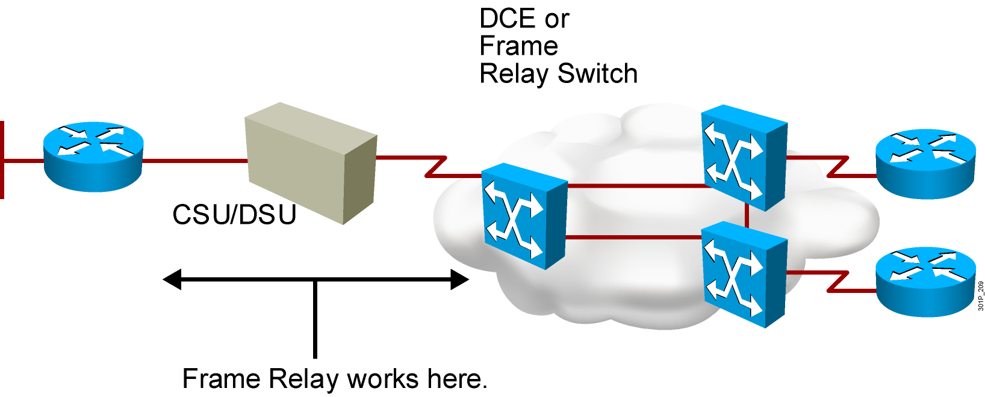
Frame Relay

Slide 20
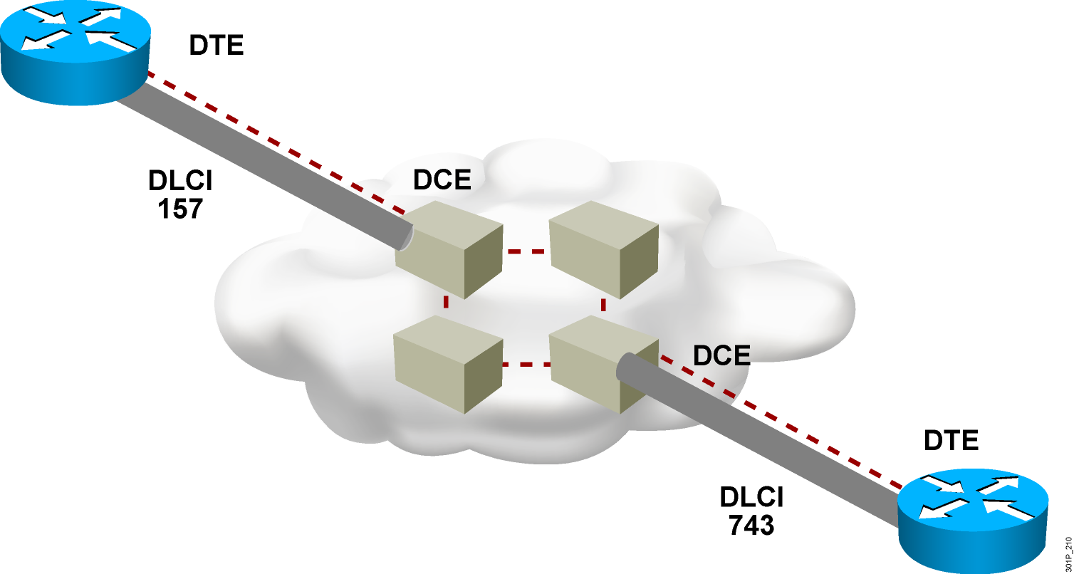
Frame Relay Devices and Virtual Circuits
Notes:
Lesson Aim
<Enter lesson aim here.>

Slide 21
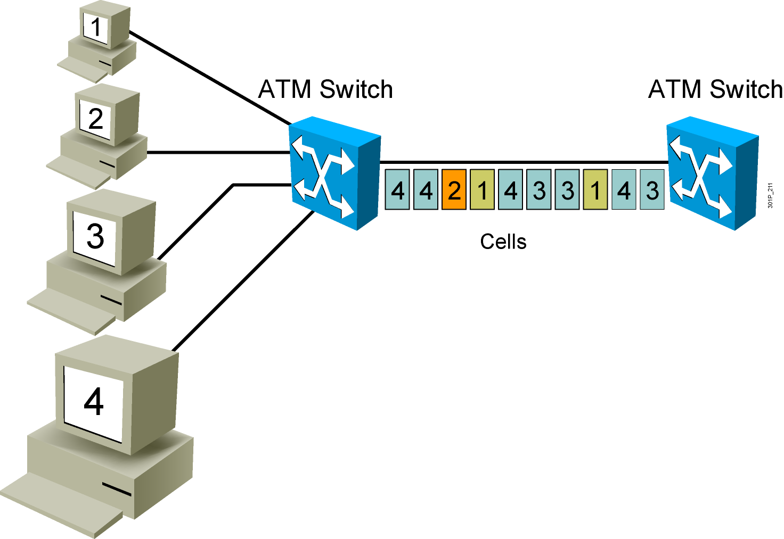
ATM and Cell Switching
Notes:
Lesson Aim
<Enter lesson aim here.>

Slide 22
Summary
  A point-to-point (or serial) line can connect two geographically distant sites. These lines are usually leased from a carrier and are, therefore, often called leased lines.
  Bandwidth refers to the rate at which data is transferred over the communication link. In North America, point-to-point leased-line bandwidth is typically specified as a DS number (DS0, DS1, and so forth) that technically refers to the rate and format of the signal.
  The HDLC protocol is one of two major data link layer protocols commonly used with point-to-point WAN connections. HDLC supports both point-to-point and multipoint configurations.
  The encapsulation hdlc interface configuration command can be used to specify Cisco HDLC encapsulation on the interface.
  PPP lower-level functions use synchronous and asynchronous physical media. PPP higher-level functions carry packets from several network layer protocols using NCPs.

Slide 23
Summary (Cont.)
  The encapsulation ppp interface configuration command can be used to specify PPP encapsulation on the interface.
  The show interface command can be used to verify proper configuration of PPP encapsulation.
  Frame Relay data rates are commonly up to 4 Mb/s, with some providers offering even higher rates. Frame Relay is a simpler protocol that works at the data link layer rather than at the network layer.
  ATM is a type of cell-switched connection technology that is capable of transferring voice, video, and data through private and public networks. ATM is used primarily in service-provider networks and enterprise LAN backbones.
  ATM virtual circuits can be either PVCs or SVCs.
Notes:
Purpose: This slide discuss the initial configurations on the routers and switches.
Note: There is no setup mode on the Catalyst 1900 switch.

